Slide 1

STARGAZERS
School project - Console Application

Slide 2

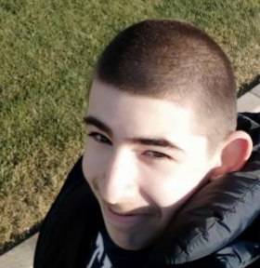
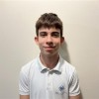
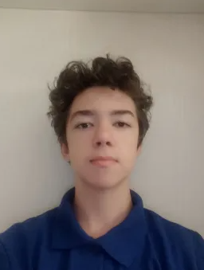
OUR TEAM
Scrum Trainer
Petar Dimitrov
Front-end Developer
Martin Dimitrov
Front-end Developer
Kaloyan Petrov
Front-end Developer
Petko Kovachev

Slide 3
Idea
We had a total of 1 month to create this Console Application.
Our idea was to create an informative Console Application about Space.
We came up with the design very quickly and got to work.

Slide 4
Realization
We realised our project through collaborative work across different online platforms and coding environments.
Every 3-4 days we held meetings to discuss progress and responsibilities of the team members.

Slide 5






USED TECHNOLOGIES

Slide 6
NOW LET'S SEE THE CONSOLE APPLICATION

